Slide 1
MVC
Rishad Nero ☺
TWITCH: rsnrcode
DISCORD: nero

Slide 2
What is MVC?
MVC stands for Model, View, Controller.
It is a method of structuring our files by emphasizing a “separation of concerns”.
It is highly recommended, especially for large projects, because it provides a better division of labour and improved maintenance.

Slide 3
Project Time!
Before diving into the three components that make up MVC, let’s keep a simple blog app in the back of our minds to help visualize what we are learning.
This blog app will allow it’s users to submit text (blog title, blog body) into a form element. Once submitted, the text will then be displayed on the main page of the website, where it can also be deleted by the user.
Without further ado, let’s dive in!

Slide 4
Models
Models are the basic building blocks of your database.
They define the types of information that get used by the Views and Controllers.
Your application will contain a model that holds the details of each entry in your database.
For our blog app, the Model would specify what data the form submissions should contain – blog title, blog body, etc. – and what submissions are already present.

Slide 5
Views
Views are the component that generate the user interface for your application. It defines how the app’s data should be displayed.
After receiving data from the Controller (which has received data from the Model), Views merges the data with the HTML structure to generate the UI.
In our blog app, the Views component will consist of the HTML, CSS, and possibly JS files.

Slide 6
Controllers
Controllers are the components that decide what view to display and what information is going to be put into it.
In other words, they contain logic that update the Model and/or View in response to input from the users of the app.
Our blog app will have input forms that allow us to add or delete blog posts. These actions require the model to be updated, so the input is sent to the Controller, which then manipulates the Model as appropriate, which then sends updated data to the View.

Slide 7
The Big Picture
It is important to note that using MVC is not necessary. MVC is simply a design pattern you can use to organize your app by splitting your code into separate files.
In the next two slides, we will be looking at an image that will help us visualize exactly what is happening.
The following figure contains numbered steps that are explained in the slide that follows it.

Slide 8
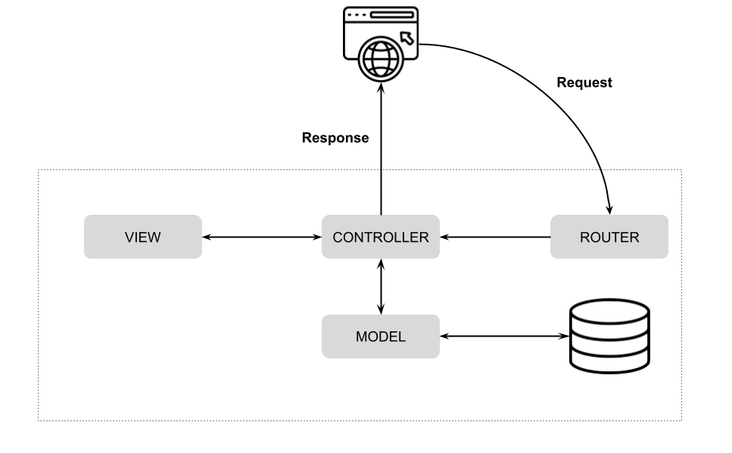
1
5
2
3
4
Figure 1: MVC Architecture Diagram. (Photo by Bilal Haidar on CODEMag).

Slide 9
MVC Architecture Diagram
The router receives a request for a page (view) from the browser (client).
The router picks a single Controller to handle the request.
The Controller decides on the View to return. The View renders the page requested by the browser.
The Controller communicates with the Model to retrieve/store any data. The Model communicates with the database, as needed.
The Controller sends a response back to the browser.

Slide 10
Resources
https://www.theodinproject.com/lessons/nodejs-express-102-crud-and-mvc
https://developer.mozilla.org/en-US/docs/Glossary/MVC
https://www.codemag.com/Article/2205071/Building-MVC-Applications-in-PHP-Laravel-Part-1

